Slide 1

Overview and Early Results
Jochen Stutz, Joost de Gouw, Jose L. Jimenez,
John Seinfeld, Jason Surratt
and

Slide 2
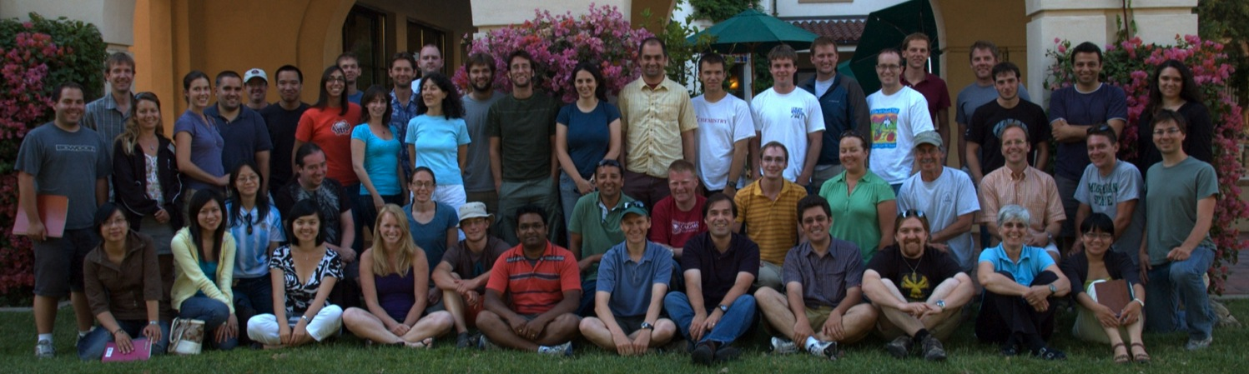
The CalNex-LA Team
Aerosol Dynamics
Aerodyne Research
Arizona State University
Baylor University
Brookhaven National Laboratory
California Air Resources Board
California Institute of Technology
Carnegie Mellon University
Consejo Superior de Investigaciones Cientificas
Droplet Measurement Technologies
Georgia Institute of Technology
Indiana University
Istituto di Scienze dell'Atmosfera e del Clima
Jet Propulsion Laboratory
Laboratoire Inter-Universitaire des Systemes Atmospheriques
Loyola Marymount University
Massachusetts Institute of Technology
Max Planck Institut fur Chemie
NOAA Air Resources Laboratory
NOAA Earth System Research Laboratory
Pacific Northwest National Laboratory
Paul Scherrer Institut
Texas Tech University
Tofwerk AG
US Environmental Protection Agency
USFS Fire Sciences Laboratory
University of Calgary
University of California-Berkeley
University of California-Berkeley
University of California-Davis
University of California-Irvine
University of California-Los Angeles
University of California-San Diego
University of Colorado-Boulder
University of Delaware
University of Houston
University of Manchester
University of North Carolina-Chapel Hill
Universite Saint-Joseph de Beyrouth
University of Toronto
University of Utrecht
University of Washington-Seattle
University of York

Slide 3
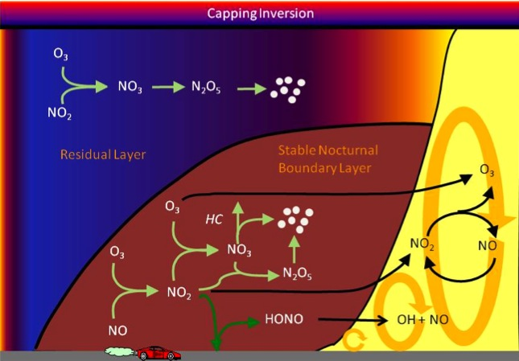
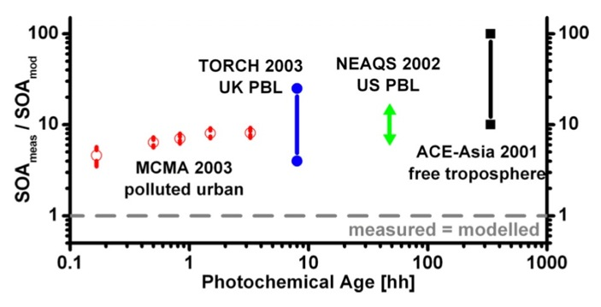
Motivation
Ozone formation in Los Angeles
Radical Chemistry / Budget
Nocturnal Chemistry and Mixing
Chlorine chemistry
NO_{y} budget
Volkamer [GRL 2006]
SOA formation with anthropogenic VOCs > biogenic VOCs
OA characterization by most comprehensive suite of instruments
Emissions and chemistry of semi-volatile organic compounds (SVOCs)
Aqueous-phase chemistry

Slide 4
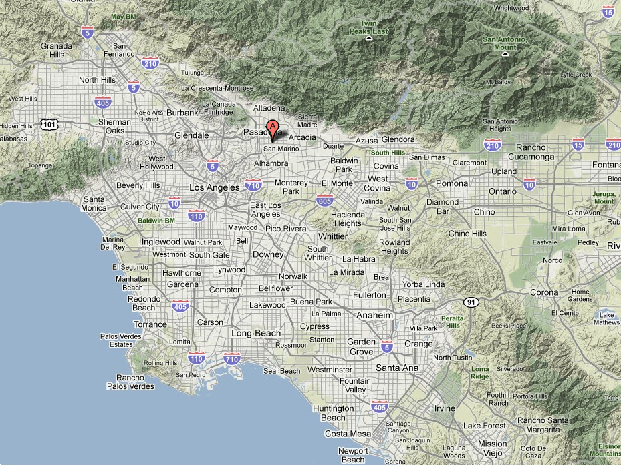
Measurement Location in Pasadena
Caltech Ground Site
Average daytime conditions:
SW wind at 1-2 m s⁻¹
2-4 h transport to LA
5-10 h transport to coast

Slide 5
Measurement Location in Pasadena
Caltech Ground Site
Average nighttime conditions:
Light and variable winds

Slide 6
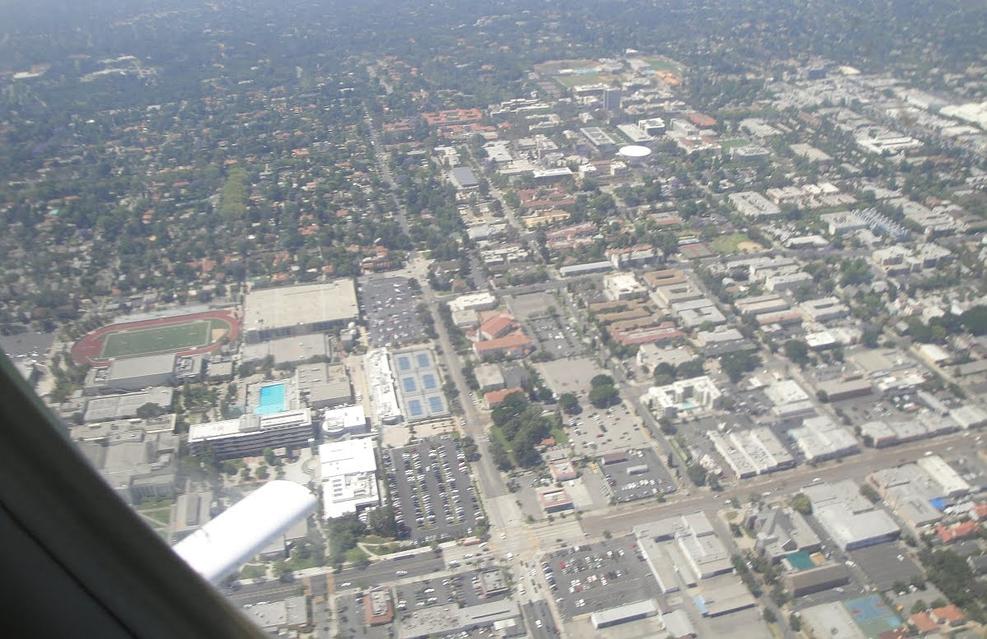
Measurement Location in Pasadena
Prevailing winds
during daytime
Caltech Ground Site
Mixed residential &
business location
Photo: Jeff Peischl

Slide 7
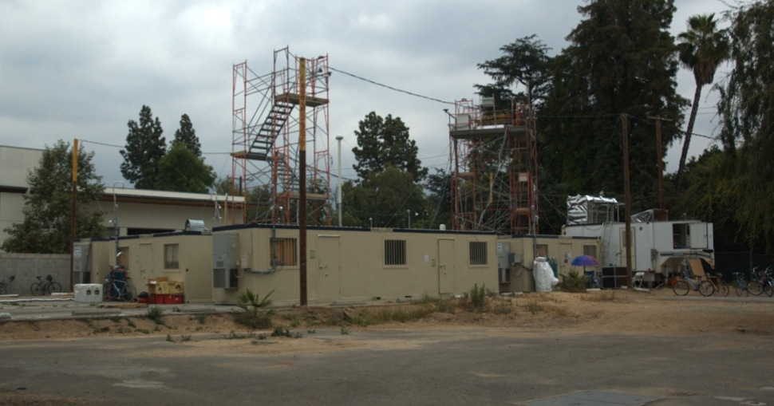
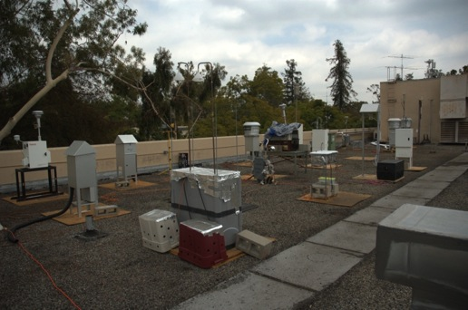
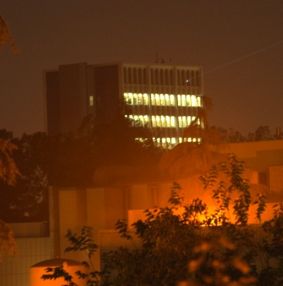
Field Setup at Caltech
Main Site
Keck Roof
Millikan Roof
Aerosol and Gas sampling towers
10m high
9 Lab Trailers (2000 sq²)
70 instr. / 16 samplers
2000 amp power
50 – 70 participants

Slide 8
Gas-Phase Measurements
VOCs | GC-MS, online VOCs | NOAA
O₃, NO₂, SO₂, NO₃, HONO, HCHO | DOAS | UCLA
OH and HO₂, OH reactivity | LIF – FAGE | Indiana Univ.
Photolysis frequencies, Total sky imager | Scanning Actinic Flux Spectroradiometer | Univ. of Houston
O₃, SO₂, NO/NO_{x}, NO_{y}, CO | UV Abs / Flour/ CL+ photolysis cell and Mo converter / VUV | Univ. of Houston
Organic acids, HONO, HNCO, HCl , HNO₃ | CIMS | NOAA
HCHO | Hantzsch reaction fluorescence | Univ. of Houston
CHOCHO, HONO, NO₂ | CEAS | NOAA
PANs | GC-ECD | NOAA
ClNO₂, PANs | CIMS | U. Calgary
CO / CO₂ | VUV / NDIR absorption | NOAA
gas phase and semivolatile organics | High-resolution PTR-TOF MS | U. Utrecht
water-soluble OC in the gas-phase | PILS and mist chamber + online WSOC | Georgia Tech
total gas-phase organics, & semivolatiles | High Resolution EI-TOF-MS | MIT
gas-phase semivolatiles | Sorbent tubes + off-line TD-GCMS | CMU
urban meteorology, eddy covariance | various | NOAA ARL
HCHO, CHOCHO, NO₂, aerosol SCD | MAX-DOAS | CU Boulder
NH₃ | QC-TILDAS | Univ. of Toronto
Soluble gases (HNO₃, NH₃) | GP-IC | CARB
13CO₂ | WS-CRDS | Caltech
Organic acids + other organics | MOVI-TOF-CIMS | Univ. of Washington
Daily canister for VOC analysis | Offline GC- FID / MS | US EPA Research
CHOCHO, NO₂ | LED-CE-DOAS | CU Boulder
Met parameters | Ground site Caltech Library Roof | NOAA / Caltech
HONO | Wet Chemical (HPLC)
semivolatile gas-phase hydrocarbons | solid adsorption and liquid extraction | Loyola Marymount

Slide 9
Aerosol Measurements
Size resolved submicron chemical comp. | High-resolution ToF-AMS (HR-ToF-AMS) | CU Boulder
Potential aerosol mass | PAM | U-Boulder & Penn State
Organic aerosol composition | Soft-Ionization HR-ToF-AMS | CU Boulder
Submicron particle number distributions | TSI SMPS | CU Boulder
SO₄ | Research-quality monitor | CARB
Total particle number | TSI Water CPC 3786 | CU Boulder
Particle number distrib.(300 nm - 10 um) | Grimm OPC 1.109 | CU Boulder
OC and EC | 1 hr Sunset Labs thermal-optical analyzer | Georgia Tech
water-soluble OC in Particles | PILS and mist chamber + online WSOC | Georgia Tech
PM2.5 carboxylic acids | PILS + ion chromatography and CIMS | Georgia Tech
1-hr molecular tracers (particles and semivol.) | TAG-AMS | UC Berkeley, Aer. Dynamics, Aerodyne, CU-Boulder
1-hr molecular tracers (part. & semivol.) | 2D Thermal-Desorption Aerosol GC-MS (TAG) | UC Berkeley, Aer. Dynamics
PM semivolatile and non-volatile organics | High-resolution PTR-TOF MS | U. Utrecht
HR-MS analysis of WSOC/N compounds | PILS-collector + Electrospray-Orbitrap UHR MS | DOE PNNL EMSL
Black carbon & coating Composition | SP-AMS | U. Manchester, UK
Black carbon | 7-Wavelength Aethalometer | U. Manchester, UK
Black carbon absorption | DMT 3-Wavelength Photoacoustic Sensor | U. Manchester, UK
Black carbon mass | DMT SP2 (Soot Particle Soot Photometer) | U. Manchester, UK
Single particle composition 200-5000nm | PALMS | NOAA
Single nanoparticle composition | NAMS | U. Delaware
Cloud condensation nuclei (CCN) spectrum | DMT CCN Counter | Brookhaven NL
Size-resolved CCN | SMPS + DMT CCN | Brookhaven NL
Ions in aerosol (SO₄, NO₃, Cl, K, etc.) | GP-IC | CARB
Particle-phase organic acids + other organics | MOVI-TOF-CIMS | Univ. of Washington
Submicron particle number distributions | TSI SMPS #2 | CU Boulder
Submicron size distribution | UHSAS | CU Boulder
Supermicron size distribution & PBAP | UV-APS | CU Boulder
Notes:
Will zap through these or take them out

Slide 10
Aerosol Measurements (cont.) + Samplers
particle extinction 532 nm | Cavity attenuated phase shift (CAPS) | Aerodyne
particle extinction 630 nm | CAPS | Aerodyne
single-particle single scattering albedo | ASTER | NOAA
aerosol LIDAR | 3-wavelength LIDAR | USFS
Column aerosol optical depth | Sunphotometry / AERONET Station | UCLA
Aerosol extinction, scattering, albedo | CRDS / integrating sphere nephelometry | TTU
Boundary layer backscatter & height | Vaisala Ceilometer | Univ. Houston / UCLA
NMR analysis of WSOC | CNR-ISAC, Italy
Organosulfates and nitrooxy organosulfates | Caltech/UNC
OOA characterization | University of York, UK)\
14C analysis of OC, EC, Water-Insoluble OC (WIOC) and WSOC (24 hr) | PSI, Switzerland
14C analysis of Total Carbon (~3 hr for 100 samples) | PSI, Switzerland
Elements and metals (2-hr resolution) | PSI, Switzerland
HR-MS analysis of organic compounds | DOE PNNL EMSL
Precursor-specific SOA Tracers | US EPA Research
Compound-Specific Stable Isotope Analysis for SOA characterization and evolution | Baylor Univ.
14C analysis of Total Carbon | US EPA Research
Molecular speciation of OA | CSIC, Spain
size resolved elements and mass in 8 sizes < PM10 | UC Davis
modified FRM - PM2.5 mass | US EPA Research)\
Microanalysis Particle Samplers | ASU
Functional Group Contributions and potentially PMF | UCSD
Sample Archiving for future analyses | Gerogia tech
Filter Sampler | CMU
Sorbent Sampler | CMU
Derivatization and direct thermal desorption with analysis by GCxGC-TOFMS | UC Berkeley
Metals and trace elements | CSIC

Slide 11
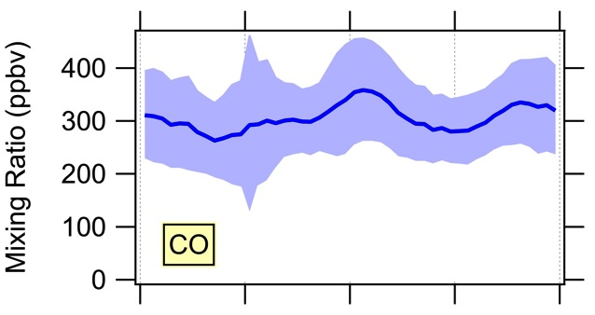
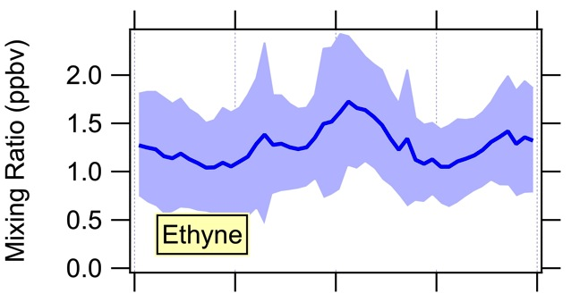
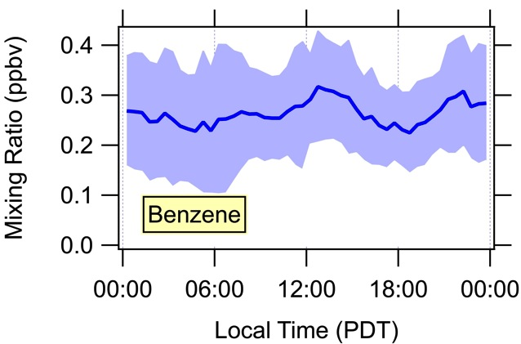
Transport of VOCs to Caltech
Transport from downtown LA direction
Inert combustion tracers are high throughout the day
Weak indications of morning rush hour
Air from downtown LA direction arrives mid day

Slide 12
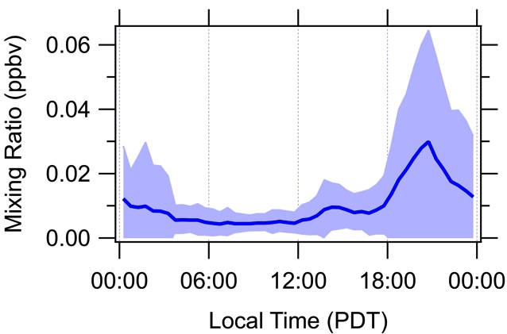
Transport of VOCs to Caltech
DMS arrives in the evening
Transport from ocean takes longer than from LA

Slide 13
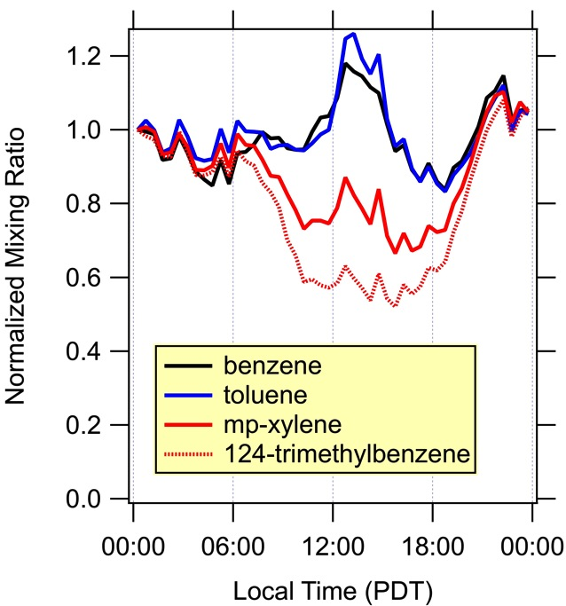
Aging of Hydrocarbons
More reactive NMHCs are relatively lower during day
Need faster photochemical clock than toluene/benzene!
OH removal

Slide 14
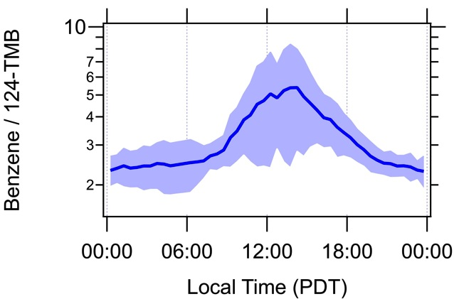
Photochemical Age
Benzene / 124-TMB could be good photochemical clock
Lower and constant age during night: good for emissions estimates?
Higher and variable age during the day
Less aged
More aged

Slide 15
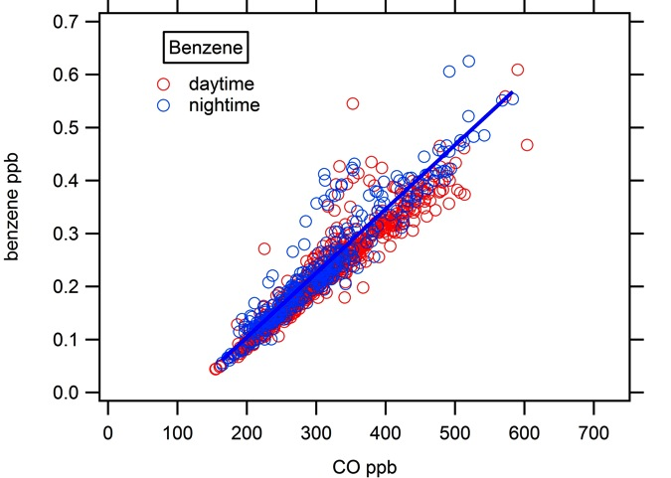
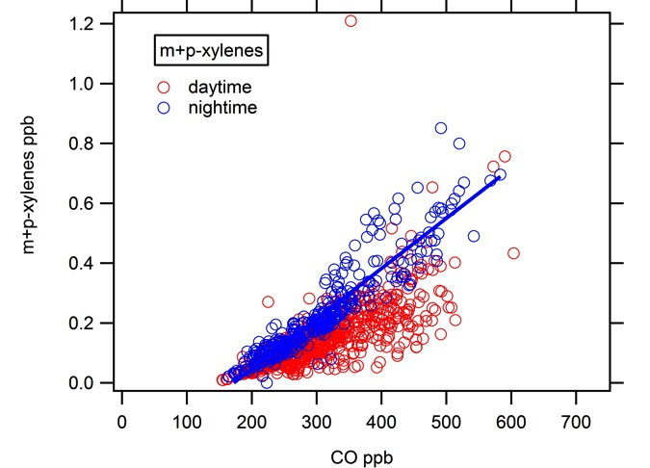
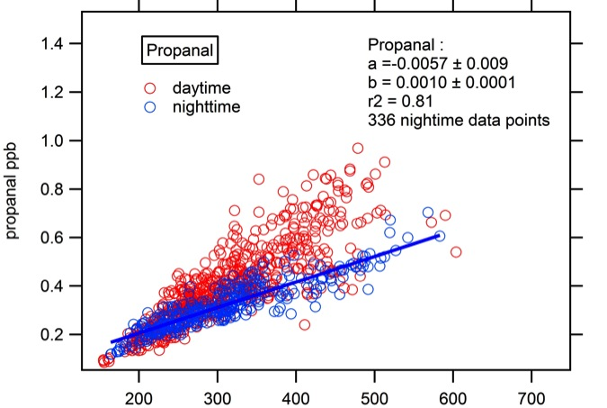
Urban VOC Emissions
Good correlations between VOCs and CO at night
Are these data suitable to estimate VOC emissions?
Daytime
production
Daytime
removal

Slide 16
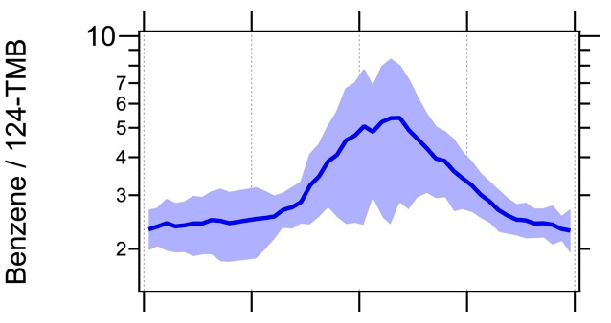
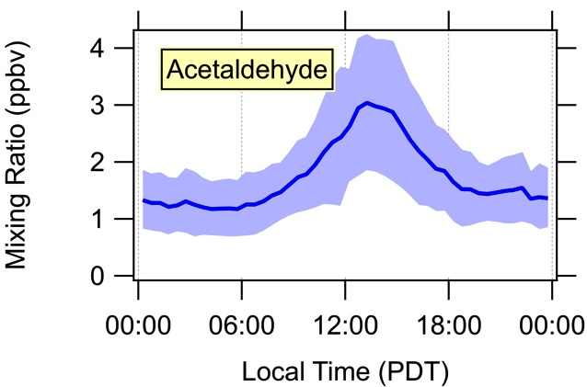
Photochemical Age
Benzene / 124-TMB could be good photochemical clock
Aldehydes and ketones are enhanced at higher photochemical age
Less aged
More aged

Slide 17
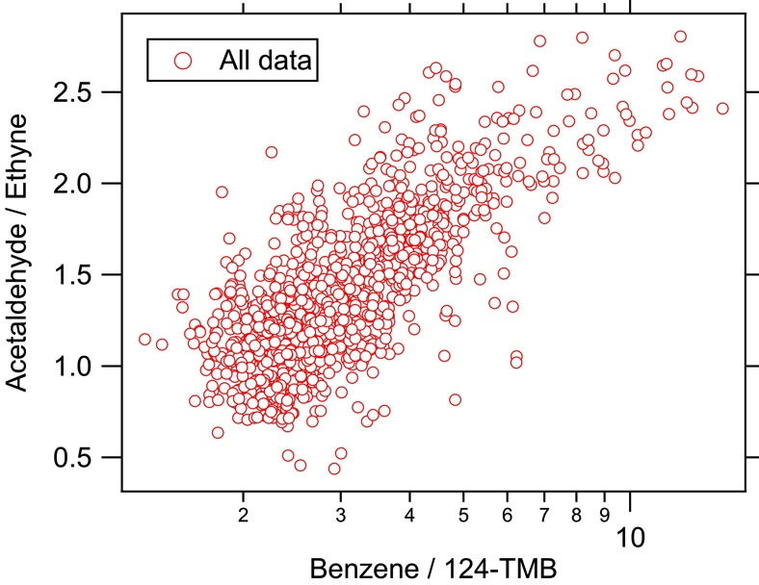
Formation of Secondary Products
Clear increase in acetaldehyde with photochemical age

Slide 18
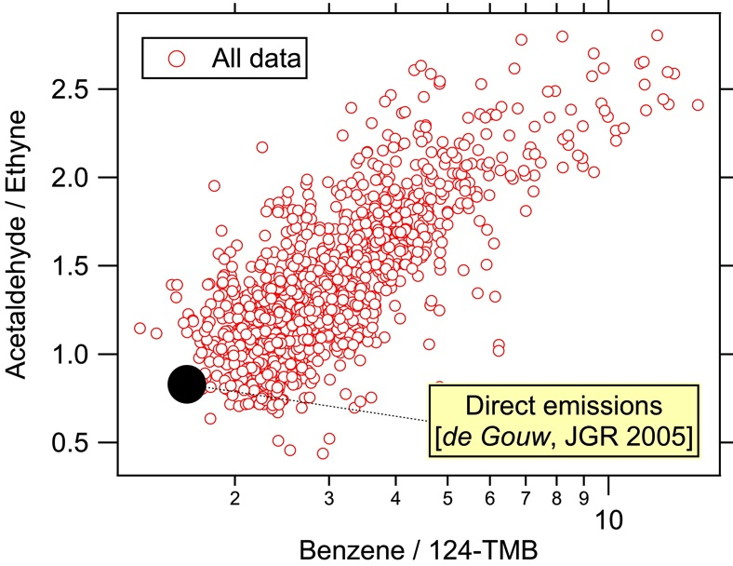
Formation of Secondary Products
Photochemical
aging
Clear increase in acetaldehyde with photochemical age
Emission ratios from NE U.S. represent lower limit

Slide 19
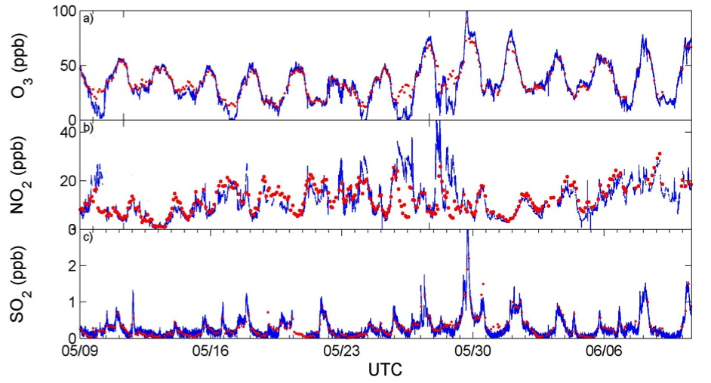
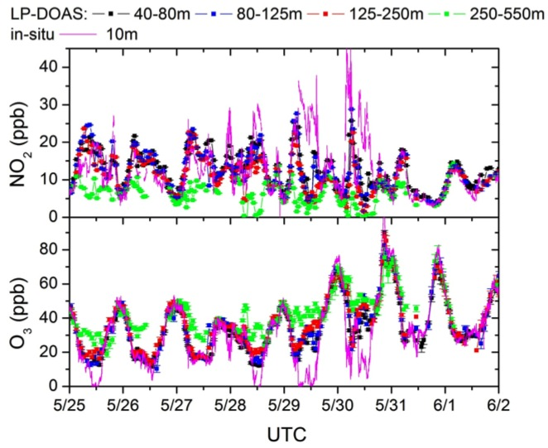
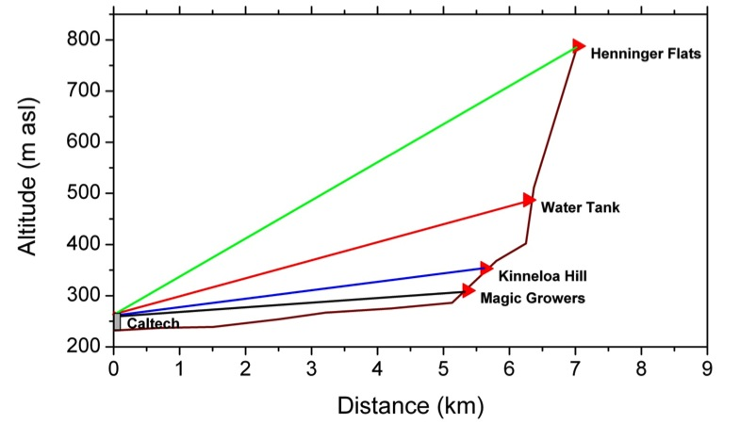
Vertical Structure at the Site (UCLA)
Comparison of in-situ with path-averaged data (5km path length) shows little difference during the day, but not at night.
data from Univ. Houston, NOAA, UCLA

Slide 20
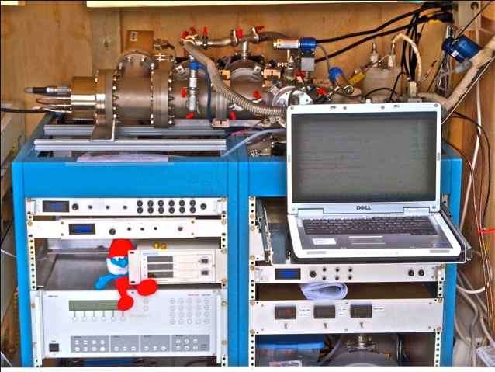
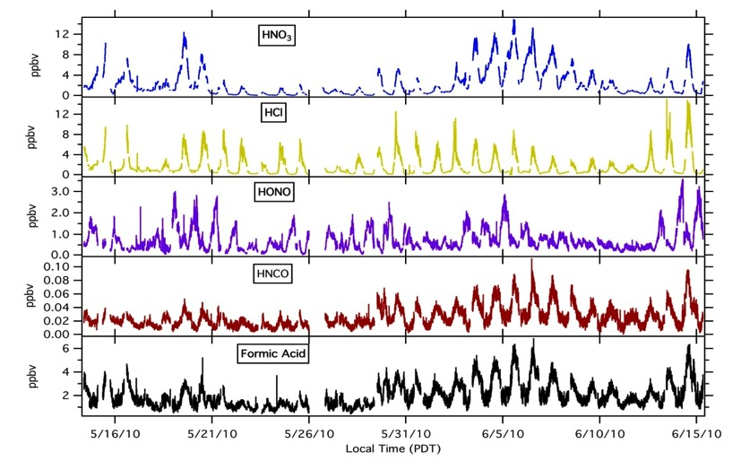
Negative-Ion Proton-Transfer Chemical-Ionization MS (NOAA)
(NI-PT-CIMS)
Veres et al. 2008, Int. J. Mass Spec.
Quantitative Measurements During CalNex 2010
Formic Acid
Acrylic acid
Methacrylic acid
Pyruvic/Butyric acid
Propionic acid
Glycolic acid
Benzenediol
Benzoic acid
Organic Acids
Inorganic Acids
HCl
HONO
HNCO
HNO₃
NI-PT-CIMS provides continuous, fast (1 second), and real-time measurements of organic and inorganic acids.
Strong diurnal variations observed are indicative of photochemical formation of the organic acids measured in Pasadena, CA

Slide 21
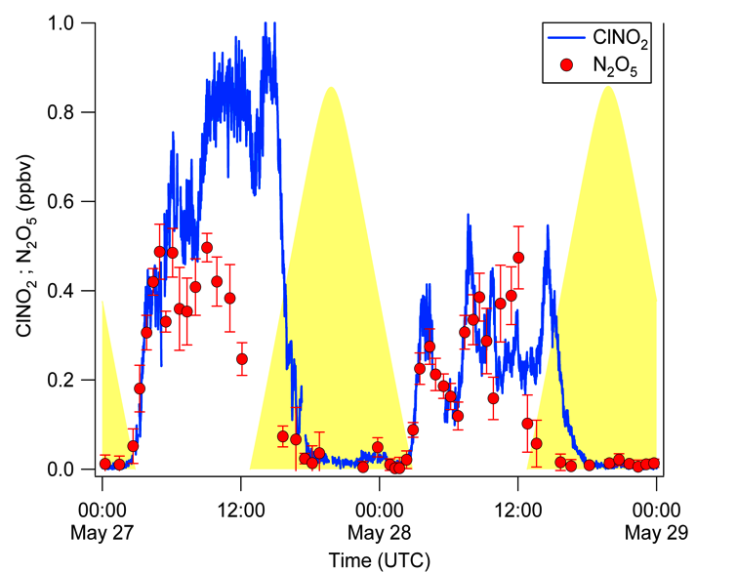
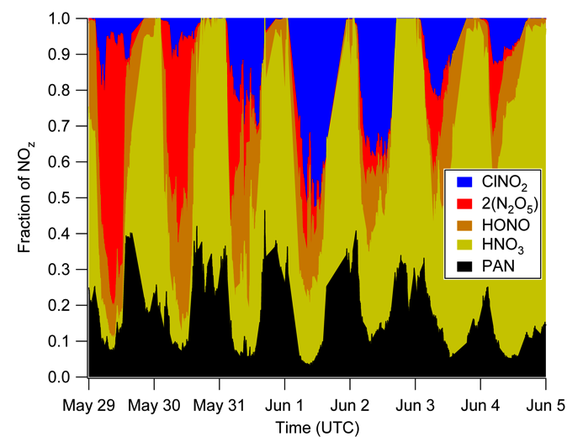
ClNO₂ chemistry (Calgary, UCLA, Houston, NOAA)
ClNO₂ up to 50% of NO_{z}
NO₂ + O₃ → NO₃ → N₂O₅ → ClNO₂
ClNO₂ + hυ → Cl + NO₂
(P_Cl) = j(ClNO₂)[ClNO₂]
Notes:
Measurements of ClNO2, a presented by Levi Mielke, University of Calgary.
ClNO2 is formed from heterogeneous uptake of N2O5 on chloride containing aerosol.
Top left shows correlation of N2O5, calculated from UCLA DOAS NO3 and NO2 (30 m above site), and ClNO2.
The two species are correlated, with ClNO2 becoming more abundant over time.
Bottom left shows calculated yields of ClNO2, relative to the integrated production rate of NO3 (maximum possible).
Campaign average over the campaign is 10%.
Top right shows a time series of NOz species measured during Calnex. At night, ClNO2 makes up to 50% of NOz.
Bottom right shows an interesting correlation of nitryl chloride photodissociation with AMS Chloride.
(note: A similar trend is seen in PILS submicron data). Part of the Cl atoms produced by photolysis appear in the submicron aerosol fraction, possibly via HCl as intermediate.
For more information, see Levi at his poster, A21C-0118.

Slide 22
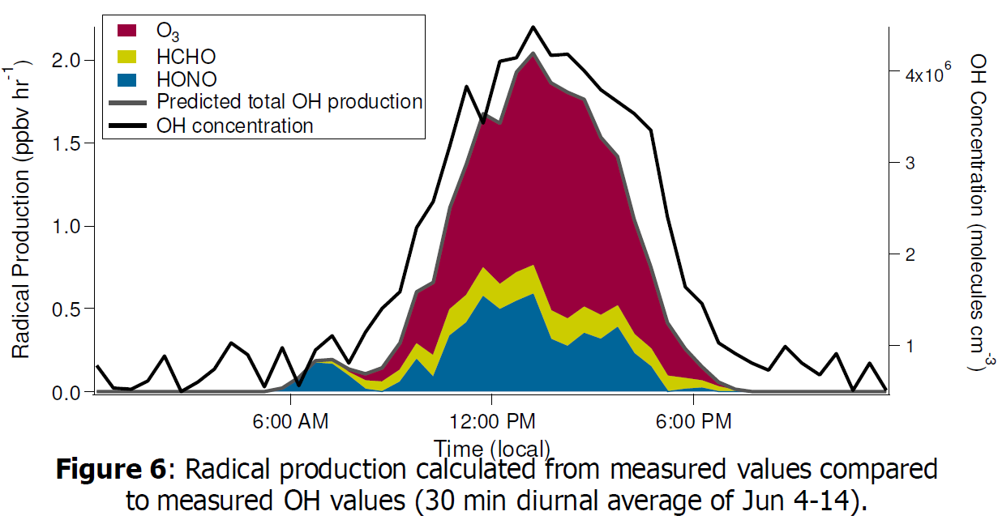
Radical Budget (NOAA, Houston, Indiana)

Slide 23
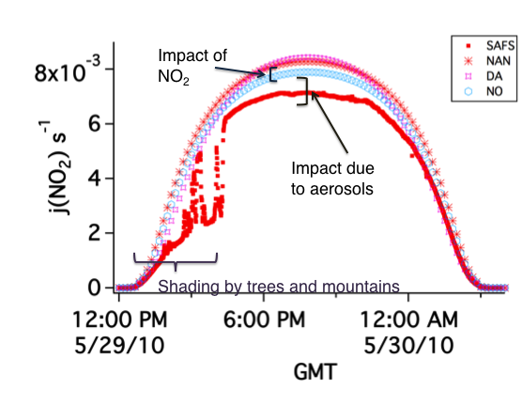
Reduction in Photolysis Rates (Univ. Houston)
In the LA basin, aerosols typically cause a 15% reduction in the photolysis of NO₂
Measured j(NO₂)
TUV No aerosols or NO₂
TUV No aerosol with 2 DU column NO₂
TUV Default urban aerosol profile

Slide 24
Summary of High-Res AMS Results (CU Boulder)
Diurnal Cycles 6/3-6/9
(reg. accumulation)
Campaign Average
Size Distributions
Strong Correlation OOA vs Ox

Slide 25
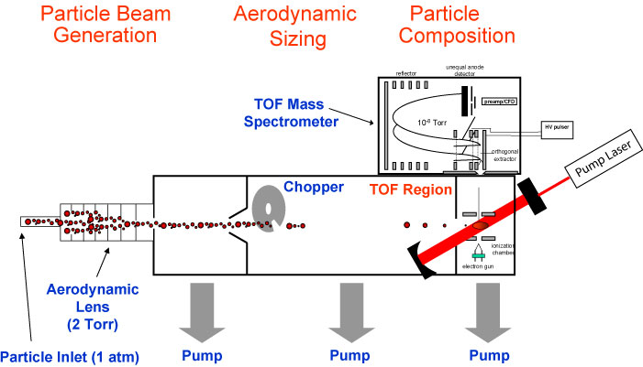
SP2-AMS measurements of BC and its Coatings
Vaporise particles containing black carbon and chemically characterises and quantify the black carbon and its coating
James Allen. Univ. Manchester

Slide 26
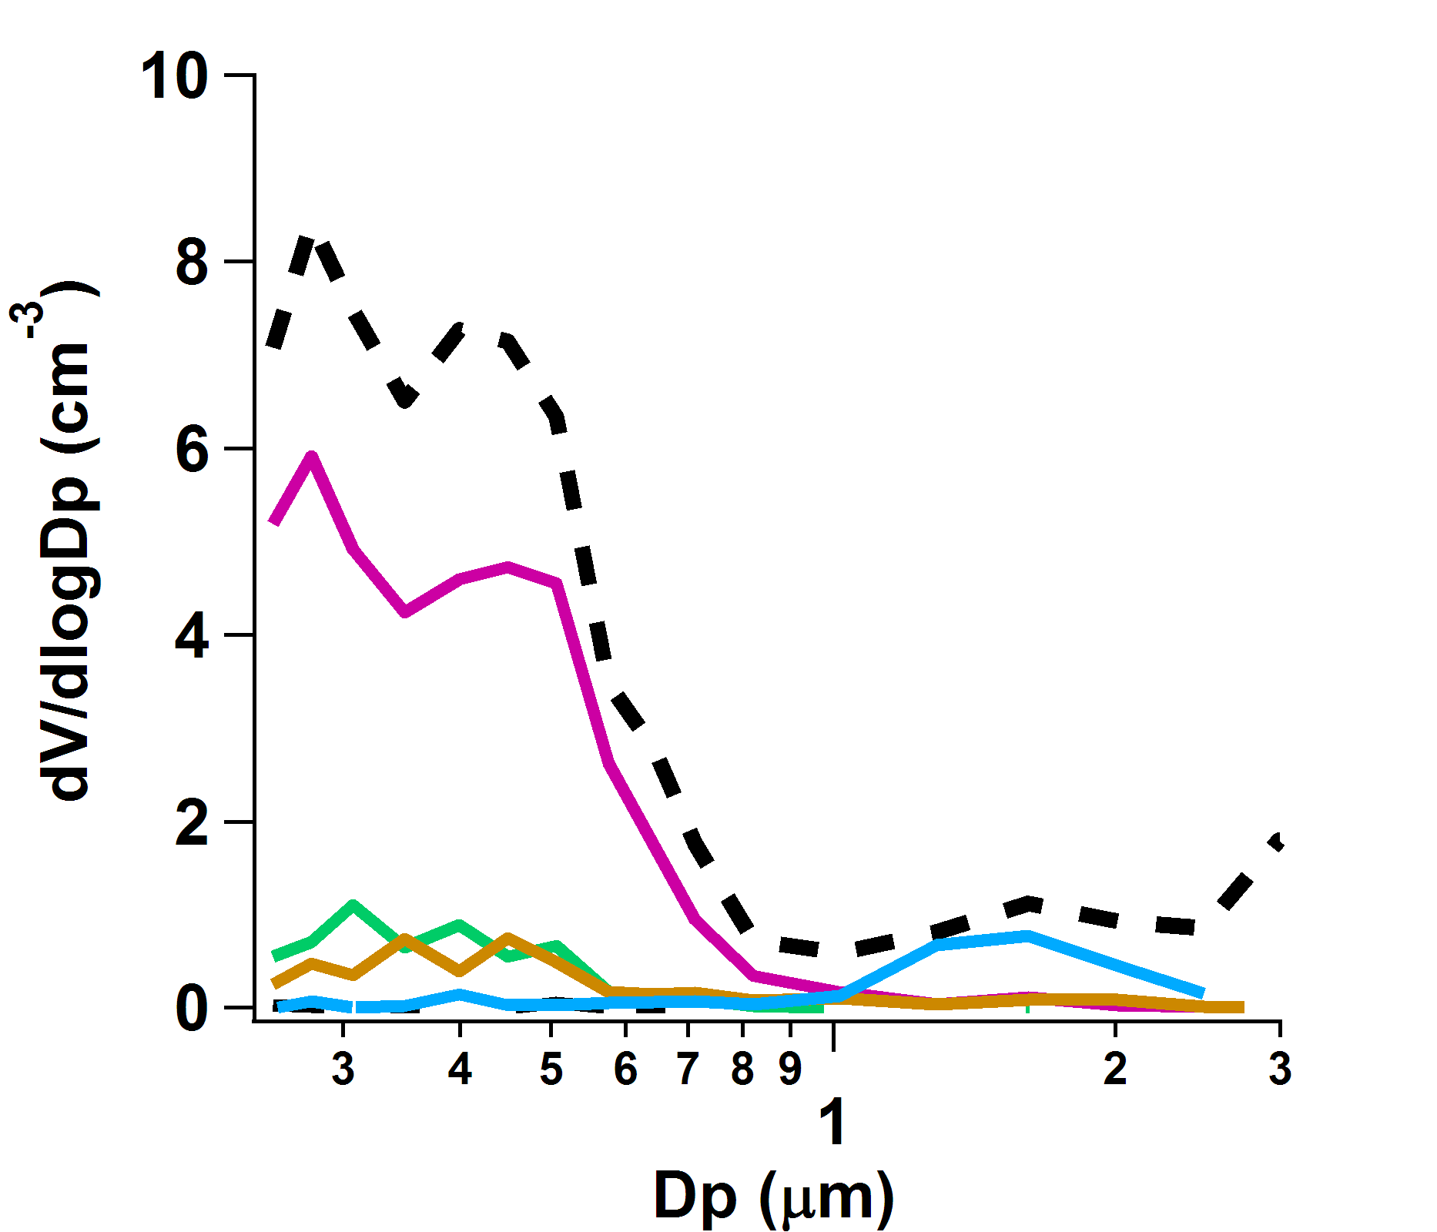
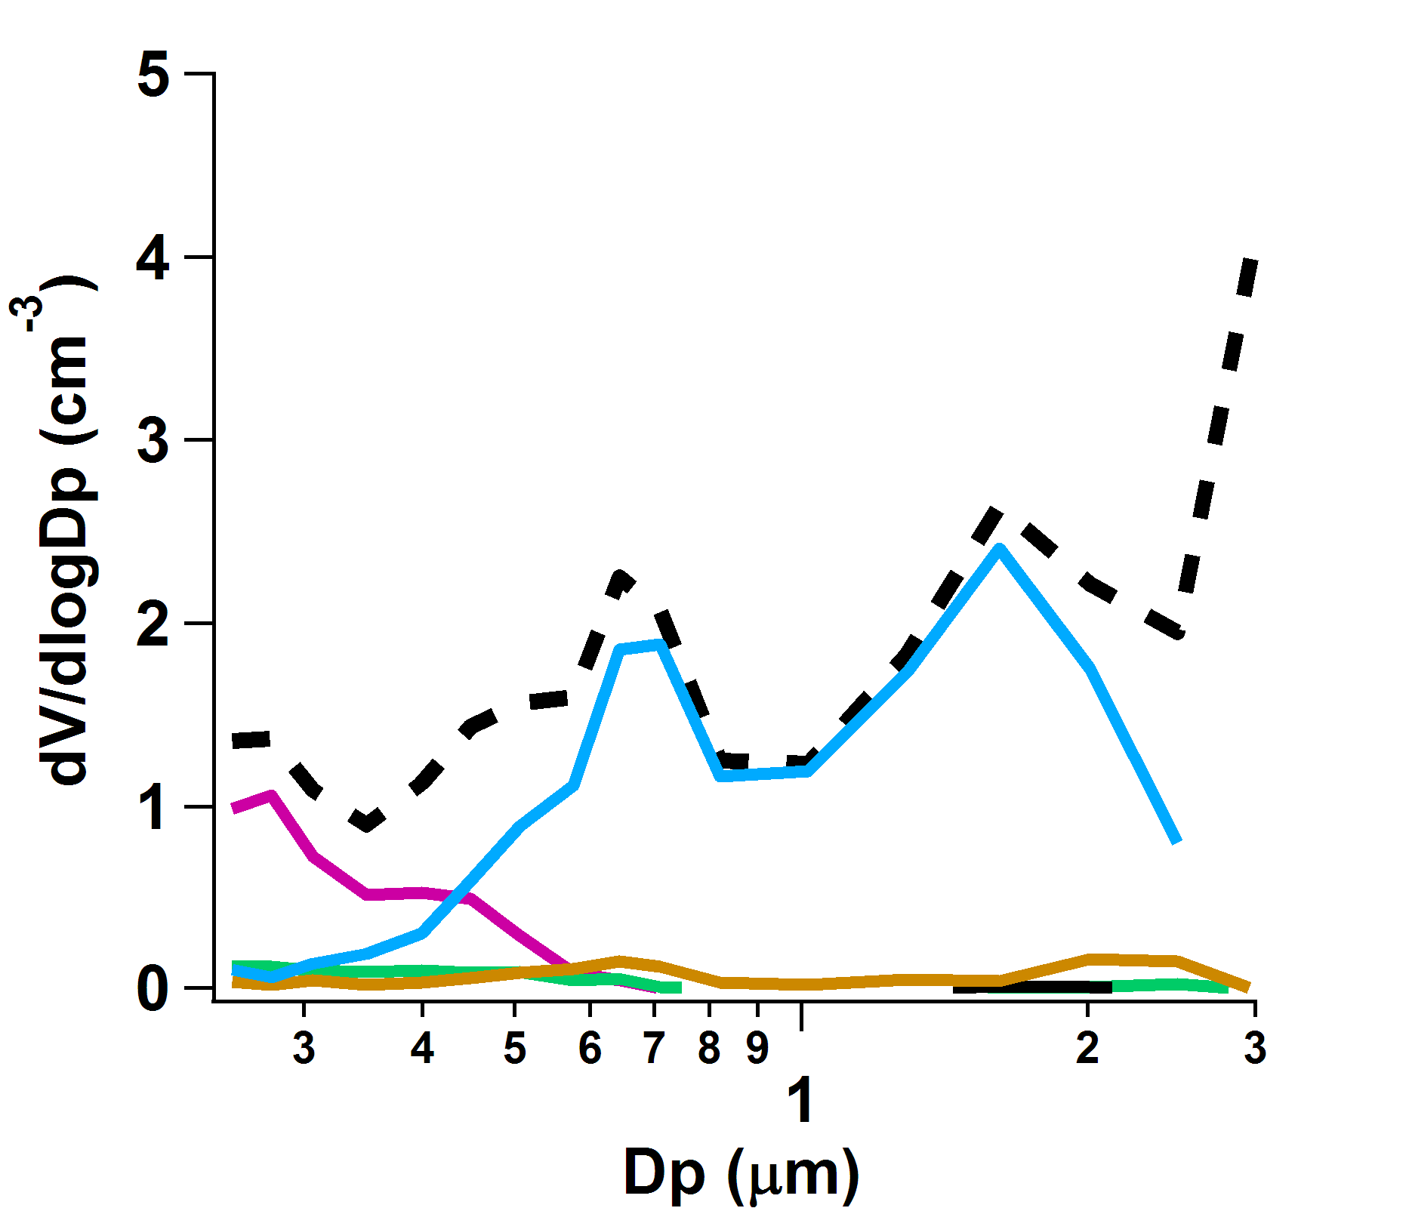
PALMS particle types mapped onto aerosol size distribution
Particle Analysis by Laser Mass Spectrometry (PALMS)
Total Volume
Mineral Dust
Sulfate-Organic-Nitrate
Sea Salt
Biomass Burning
Polluted - June 5
‘Haze’ particles dominate
Clean – May 21
Coarse mode Sea Salt dominates
K. Froyd, NOAA

Slide 27
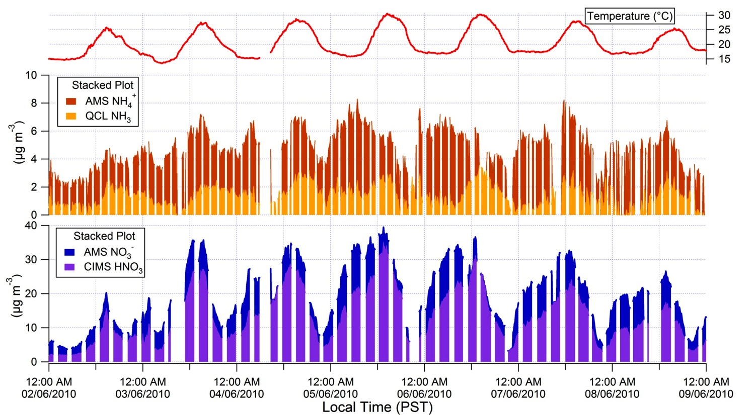
Gas – Particle Partitioning of Reactive Nitrogen
Ammonia is limiting the formation of NH₄NO₃ (Raluca Ellis, Univ. Toronto)
CIMS (NOAA ESRL), AMS (U Colorado) , QCL (U Toronto)

Slide 28
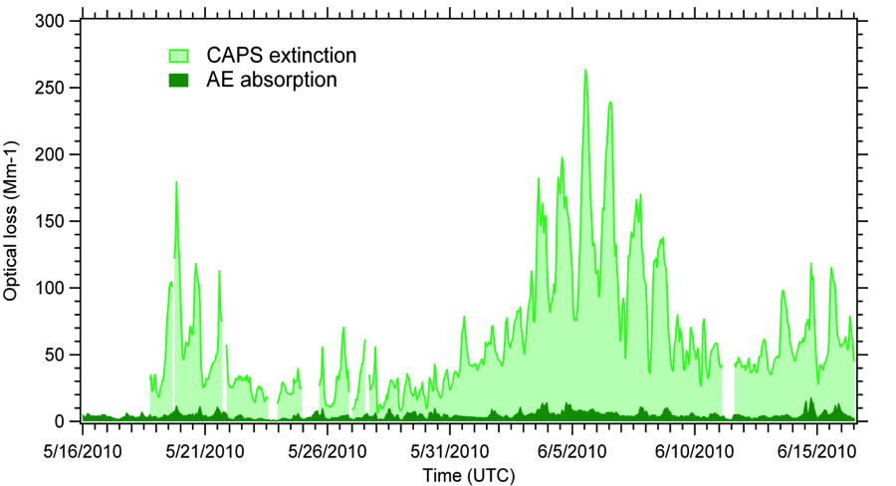
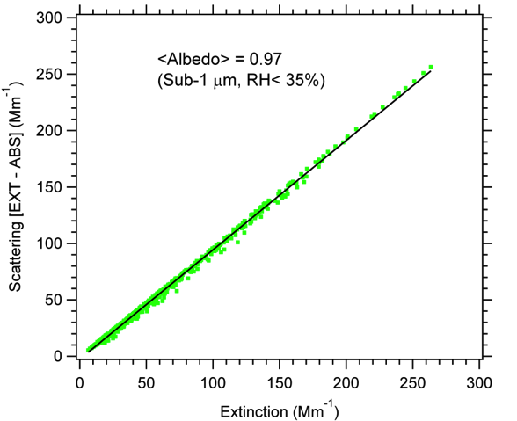
Aerosol Optical Properties (ARI, Manchester)
532 nm
Total extinction measured by the ARI Cavity Attenuated Phase Shift (CAPS) instrument
Total absorption measured by the U. of Manchester Aethalometer (AE)
Data are for 532 nm, sub-μm size cut, ~35 %RH, and reported as hourly averages
The particles measured at the CalNex –LA site exhibited scattering properties, giving an overall single scattering albedo (SSA) of 0.97 throughout the campaign
Paola Massoli, Aerodyne Research Inc
James Allan, Jonathan Taylor, University of Manchester

Slide 29
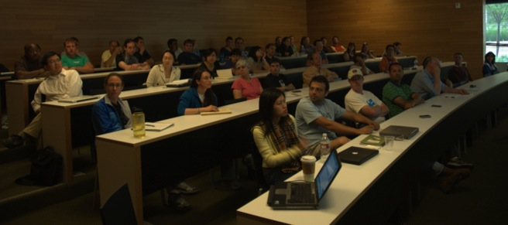
Conclusions & Acknowledgements
Comprehensive gas-phase and aerosol chemistry/physics field experiment from May 15 – June 15 2010 at Caltech.
Large number of new instruments were deployed for the first time during CalNex-LA.
Expect new insights into radical chemistry and SOA formation.
More info on CalNex-LA at: tinyurl.com/CalNex
Thank You!
California Air Resources Board
NOAA
NSF
Many other funding agencies
California Institute of Technology

